Slide 1
Phylum – Mollusca
Latin word - Mollis – Soft body
The term ‘Mollusca’ was first applied by Aristotle to cuttle fish.
Salient features:-
Mostly aquatic (Marine, Freshwater), Terresterial.
Mostly free living some are parasite.
Bilateral symmetry although some Gastropods and cephalopods becomes asymmetrical.
Body is soft and unsegmented except - Monoplacophora.

Slide 2
Phylum – Mollusca
Body is differentiated into four parts i.e. Foot, Mantle, Visceral Mass and Head.
Externally covered by hard shell made up of calcium carbonate.
The outer surface of Mantle secretes a hard calcareous shell forming a protective covering of the body.
It may be bivalved or, univalved, spiral or, cone like, internal or, reduced or, even absent.

Slide 3
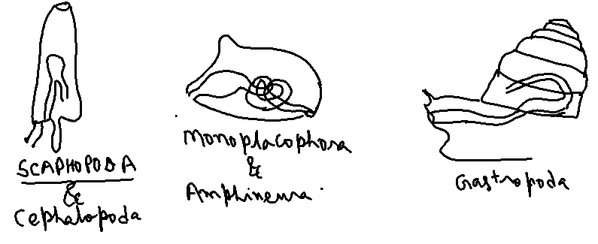
Phylum – Mollusca
The alimentary canal is of complete type and either straight, coiled or, U shaped.

Slide 4
Phylum – Mollusca
The nervous system consists of paired cerebral, pleural, pedal and visceral ganglia joined by longitudinal and cross connectives and nerves.
The sensory organs consists of eyes, tentacles, lithocyte in foot and osphradia at the base of gills.
Circulatory system is of open type.
The dorsal heart, having one to four atria and one ventricle.

Slide 5
Phylum – Mollusca
The excretory system comprises one to six pairs of nephridia, organ of Bojanus (in bivalved)
Unisexual or, bisexual.
Fertilization is external or, internal.
Development is direct or, indirect.

Slide 6
Phylum – Mollusca
It is classified into six classes:-
Class 1 Monoplacophora
Body is oval and bilateral symmetry with internal metamerism.
Univalved
Foot is ventral with a flat creeping sole.
2ventricles, 5 or, 6 pairs of gills and 6 pairs of nephridia.
Ex – Neopilina

Slide 7
Phylum – Mollusca
Class 2:- Amphineura
All are marine.
Body oval, long or, Cylindrical and bilateral symmetry.
Tentacles and eyes are absent.
Body naked or, covered with hard shell consisting of 8 transverse plates on dorsal surface.
1 ventricle, 1 pair of nephridia.
Ex – Chiton, Neomenia

Slide 8
Phylum – Mollusca
Class 3:- Scaphopoda
Burrowing and marine molluscs.
Body is elongated without distinct head, Bilateral symmetry.
Gills and eyes are absent.
Foot small, conical usually pointed for burrowing.
Shell and Mantle univalved, cylindrical or, tubular and open at both ends.

Slide 9
Phylum – Mollusca
Class 3:- Scaphopoda
Unisexual and gonads are single.
Ex – Dentalium, Cadulus

Slide 10
Phylum – Mollusca
Class 4:- Gastropoda
Asymmetry (Undergoes torsion, detorsion and coiled)
Marine, fresh water or, terrestrial.
Head is distinct with one or, two pairs of tentacles.
Shell is univalved, often spiral, conical or, absent.
Nephridia 1 or, 2.
Unisexual or, Bisexual.
Ex – Pila (Apple snail), Helix (Garden snail), Limax (Slug) etc.

Slide 11
Phylum – Mollusca
Class 5:- Pelecypoda
Mostly marine, few are in fresh water.
Body bilaterally compressed.
No distinct head and without radula, tentacles.
Shell is bivalved one on right and other at left.
Foot anteroventral and wedge shaped.
Unisexual.
Ex – Unio(Fresh water mussel), Pecten, Pearl oyster etc.

Slide 12
Phylum – Mollusca
Class 6:- Cephalopoda
Exclusively marine.
Bilaterally symmetrical.
Distinct head with large eyes.
Foot is modified into arms or, tentacles attached to head.
Unisexual.
Development is direct
Ex – Sepia (Cuttle fish), Loligo (Squid), Octopus (Devil Fish), Nautilus

